Slide 1
PROJECT PROGRESS PRESENTATION ON
COLLEGE RECOMMENDATION SYSTEM
Presented By:
Bishwa Kandel (SEC078BCT009)
Rabi Chandra Aryal (SEC078BCT023)
Shashank Katuwal (SEC078BCT032)
Sumesh Dhonju (SEC078BCT034)
Project Supervisor:
Er . Manoj Rokaya

Slide 2
INTRODUCTION
The project focuses on the design and development of a conversational system that automates admission-related queries using natural language processing
AND
enabling users to explore colleges through a web-based chatbot interface, and presents data using interactive visualizations.
2

Slide 3
PROBLEM STATEMENT AND SOLUTION
Problem Statement :
Choosing the right college is challenging for students due to scattered, unreliable information and limited access to effective, user-friendly guidance platforms.
Solution :
College Recommendation System
This system solves the problem by allowing users to explore colleges through a web-based chatbot interface.
3

Slide 4
OBJECTIVE
To develop a conversational system capable of automating admission-related query handling through natural language understanding and intelligent response generation.
4

Slide 5








IMPLEMENTATION ELEMENTS :
LANGUAGES/
STACK:
TOOLS:
5

Slide 6
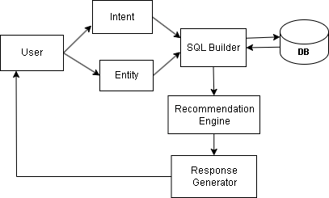
Figure : Working of Chatbot
6

Slide 7
METHODOLOGY
7

Slide 8
HOW ARE THE RESPONSES GENERATED ?
8

Slide 9
STEP 1 :
User Input in Natural Language
Where is Sagarmatha Engineering College?
9

Slide 10
STEP 2:
Intent and Entity Extraction
i . Intent
Where is Sagarmatha Engineering College?
Predicted Intent : college_location
Confidence : 0.67
Top 3 Predictions :
1 . college_location : 0.67
2 . college_info : 0.12
3 . college_contact : 0.09
10

Slide 11
How are intent Extracted ?
a . Collect and Label Training Data
[
{
"query": "What is fee of SEC",
"intent": "fee_structure"
},
{
"query": "Cutoff Rank for SEC",
"intent": "cutoff_rank"
},
{
"query": "Courses offered in SEC",
"intent": "courses_offered"
}
]
11

Slide 12
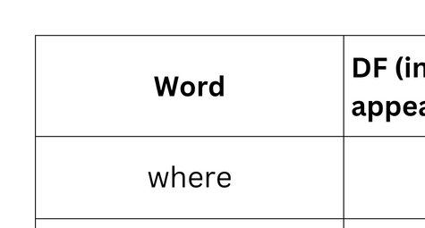
b. Convert Text to Numerical Feature Vectors
TfidfVectorizer
["where", "is", "SEC", "suggest", "a", "for", "bct", "in", "lalitpur", "what", "are", "the", "hostel", "facilities", "available"]
12

Slide 13
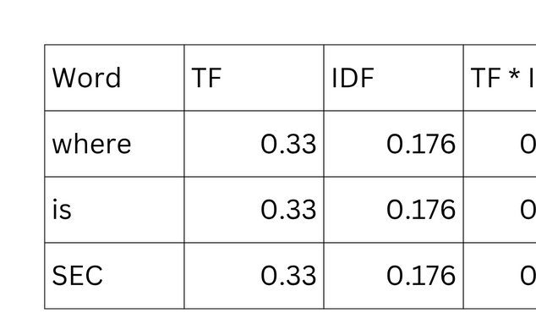
Query: "Where is SEC?
Words present: “where” “is” “sec”
Term Frequencies (TF):
Since each word appears only once in this query of 3 words:
TF = 1 / 3 = 0.333
[0.0352, 0.0352, 0.0352, 0.0352, 0.0, 0, 0, 0, 0, 0, 0, 0, 0, 0, 0, 0, 0]
[0.0352, 0.0352, 0.0352, 0.0352, 0.0, 0, 0, 0, 0, 0, 0, 0, 0, 0, 0, 0, 0]
TF-IDF vector
[0.058, 0.058, 0.058, 0, 0, 0, 0, 0, 0, 0, 0, 0, 0, 0, 0, 0, 0]
13

Slide 14
c. Split the dataset
Training - 80% – Test - 20%
d. Initialize Random Forest Classifier
200 trees (n_estimators=200) and no maximum depth (max_depth=None)
e. Train and Evaluate the model
f . Save the model and Vectorizer
g. Transform New Query Using Saved Vectorizer and Extract Intents
14

Slide 15
ii . Entity
How are entity Extracted ?
Sagarmatha Engineering College has Civil , Computer and Electronics but SEC does not have chemical
Sagarmatha Engineering College ---
Civil -------------------------------------------
Computer -----------------------------------
Electronics ---------------------------------
SEC -------------------------------------------
chemical ------------------------------------
College
Course
Course
Course
College
Course
15

Slide 16
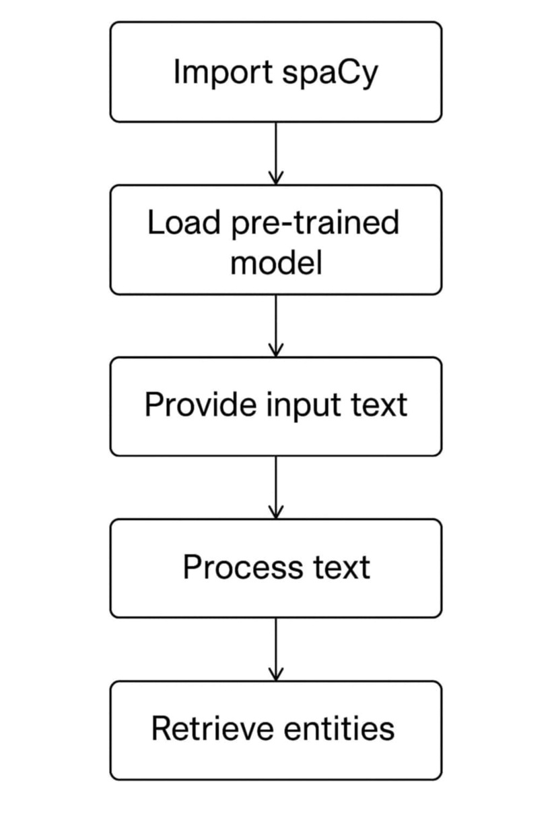
Figure: Named Entity Extraction using spaCy
16

Slide 17
Training Data
[0.0352, 0.0352, 0.0352, 0.0352, 0.0, 0, 0, 0, 0, 0, 0, 0, 0, 0, 0, 0, 0]
[0.0352, 0.0352, 0.0352, 0.0352, 0.0, 0, 0, 0, 0, 0, 0, 0, 0, 0, 0, 0, 0]
TRAIN_DATA = [
(
"Sagarmatha Engineering College is located in Lalitpur and offers BCT program.",
{"entities": [
(0, 32, "COLLEGE"), --> ( START_INDEX , ENDING_INDEX , “ENTITY”)
(45, 53, "LOCATION"),
(64, 67, "COURSE")
]})]
17

Slide 18
STEP 3:
User Query :
Show me names of private engineering colleges in Lalitpur with hostel.
SQL Builder
Intent: find_colleges
Entities :
Type: private
Course: engineering
Location: Lalitpur
Facility: hostel
SELECT Name FROM Colleges
WHERE Type = 'Private'
AND Course LIKE '%Engineering%'
AND Location = 'Lalitpur'
AND HostelAvailability = 1;
18

Slide 19
Name
Sagarmatha Engineering College
Advanced College of Engineering
Response Formatter
Here are some colleges matching your request:
- Sagarmatha Engineering College is a private college in Lalitpur with hostel.
- Advanced College of Engineering is a private college in Lalitpur with hostel
19

Slide 20
Reponse Formatter
Response Formatter can extend from simple python function :
def format_results(results):
if not results:
return "No colleges found."
response = "Here are some matching colleges:\n"
for row in results:
response += f"- {row[1]}\n"
return response
to complex Natural Language Generations
20

Slide 21
PROJECT PROGRESS
21

Slide 22

WORK ACCOMPLISHED
Entity
Fig. Training Data
Fig. Input for Entity Extraction
Fig. Extracted Entity from given input
22

Slide 23
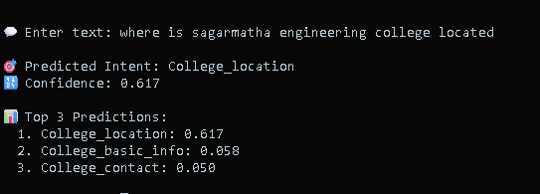
Intent
23

Slide 24
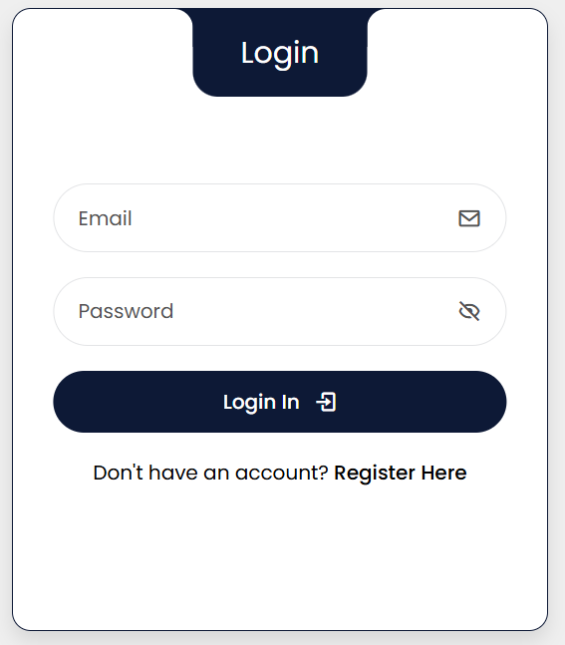
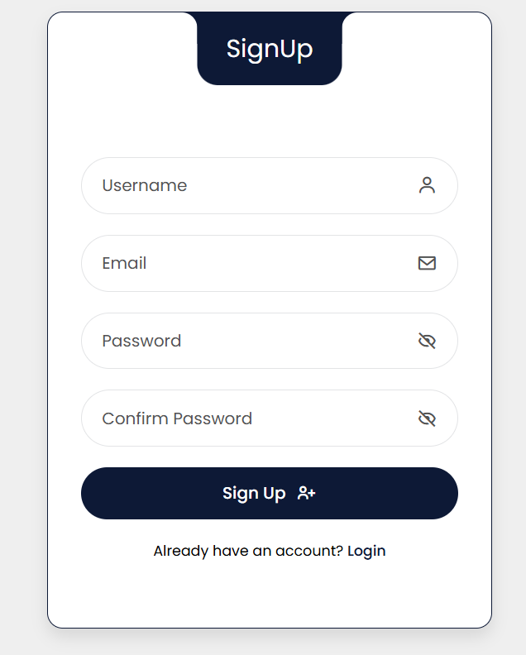
User Interface
UI snippet : Login
UI snippet : Signup
24

Slide 25
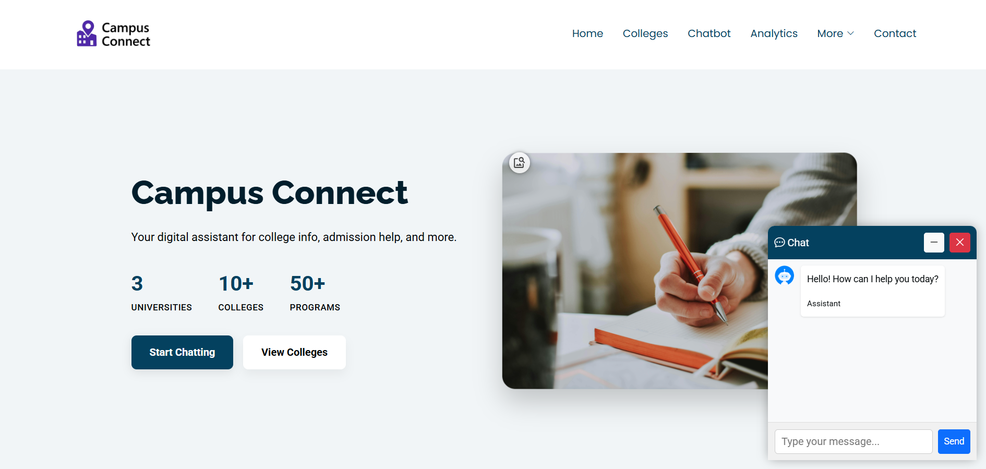
UI snippet : Landing Page with ChatInterface
25

Slide 26
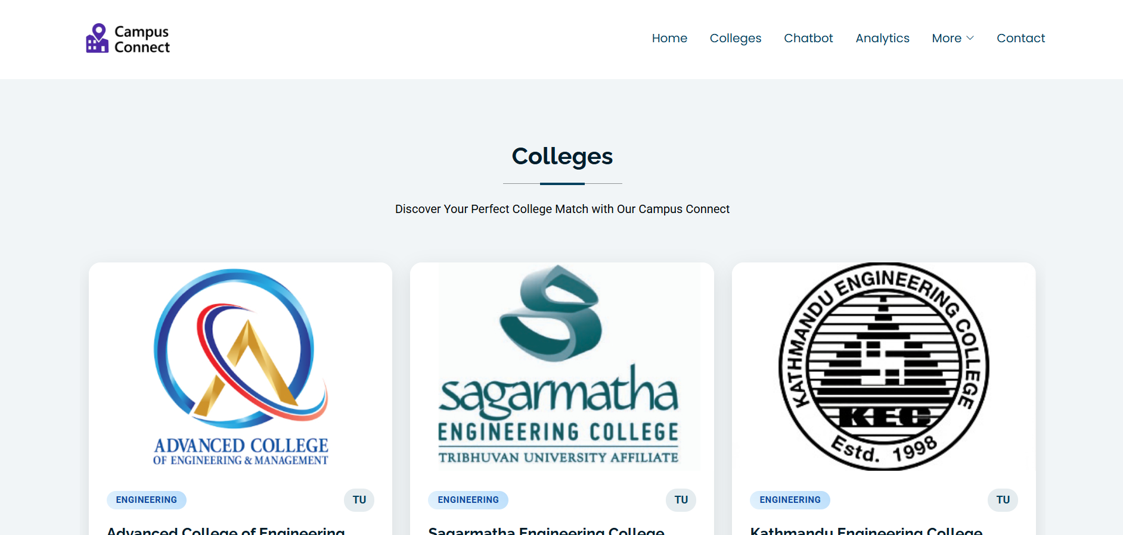
UI snippet : College Listing Page
26

Slide 27
WORK REMAINING
Web UI | Chatbot | Database and API
Refine Chat Interface Add Data Visualization part Add Admin Panel for CRUD operations | Intent and Entity Accuracy Improvement Chatbot Response Formatter Design and Develop SQL Builder | Chatbot API response to Frontend Add data entries for every colleges
27

Slide 28
CONCLUSION
The College Recommendation System efficiently interprets user queries and delivers accurate, relevant responses using intent recognition and entity extraction. By automating data retrieval and providing structured results, it simplifies the college search process and enhances the overall user experience.
28

